Slide 1
SkanVet ALTA

Slide 2
SkanVet ALTA High Power X-rays table for companion animals
Xrays subsystem main features:
High Frequency-High power generator with rotating anode tube
32 kW power (100kV-320mA-100msec)
Range 40-125 kV with 1kV steps
Range 25-400 mA with automatic kV association
Range 1msec-6.3sec exposure times
0.6-1.3 Focal Spots
110V-230V AC mains power supply
1mt fixed SID

Slide 3
SkanVet ALTA High Power X-rays table for companion animals
Table main standard features:
Modular design for easy installation and service (one person required)
Standard 4-ways floating table supporting max. 100kgs
Standard removable cassette tray 43X43 max.
Mechanical brakes operated by pedals
Hooks for animal immobilization ropes
Standard single action wired xrays pedal and handswitch
Standard accessories kit (leaded garment, immobilization ropes etc.)

Slide 4
SkanVet ALTA High Power X-rays table for companion animals
Optional features:
Carbon fiber 4-ways floating table supporting max. 100kgs
RX grid with support
Wireless pedal board (w/rechargeable Lithium battery)
Vinyl graphics available in 4 colors
Choice of digital detectors of various types and sizes

Slide 5
SkanVet ALTA High Power X-rays table for companion animals
3 Models available:
PLUTO: Radiographic table with 32kW monobloc and 9” colour touch screen, 2 and 3 points techniques, multilingual support, anatomic configurations; cassette tray for CR/DR 43x43 max size;
URANUS: Radiographic table with 32kW monobloc, all-in-one solution with Tigerview imaging software, on board PC and hi-resolution 15” touch screen colour display;
43x35 or 43x43 digital detector in removable cassette tray
JUPITER: Radiographic table with 32kW monobloc, Tigerview imaging software on external workstation (laptop or desktop), 15” touch screen colour display for image preview and technique factors adjustment;
43x35 or 43x43 digital detector in removable cassette tray

Slide 6
SkanVet ALTA High Power X-rays table for companion animals
Models/features: | Pluto | Uranus | Jupiter
32 kW generator | ☑ | ☑ | ☑
Modular design | ☑ | ☑ | ☑
4 ways floating table | ☑ | ☑ | ☑
Carbon floating table | optional | optional | optional
Removable cassette tray | ☑ | ☑ | ☑
Mechanical table brakes | ☑ | ☑ | ☑
Hooks for ropes | ☑ | ☑ | ☑
Single action xrays pedal | n/a | optional | ☑
Accessories kit | optional | ☑ | ☑
RX grid w/support | optional | optional | ☑

Slide 7
SkanVet ALTA High Power X-rays table for companion animals
Models/features: | Pluto | Uranus | Jupiter
Wireless xrays pedal | n/a | optional | ☑
Choice of vinyl graphics | ☑ | ☑ | ☑
Integrated workstation | n/a | ☑ | n/a
Preview on-board touch screen | n/a | ☑ | ☑
Tigerview imaging SW | n/a | on board | on ext.ws
Generator operator panel | ☑ | n/a | n/a
Customized APR tables | ☑ | ☑ | ☑
43x35 OR 43x43 digital detector | n/a | ☑ | ☑

Slide 8
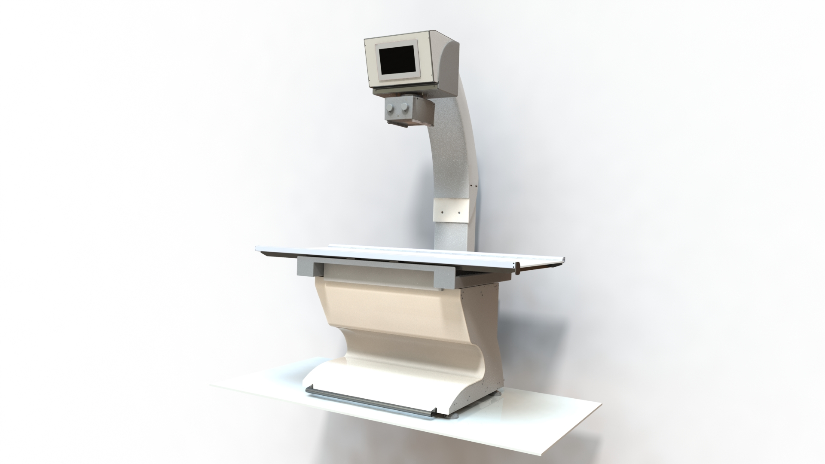
SkanVet ALTA High Power X-rays table for companion animals
PLUTO

Slide 9
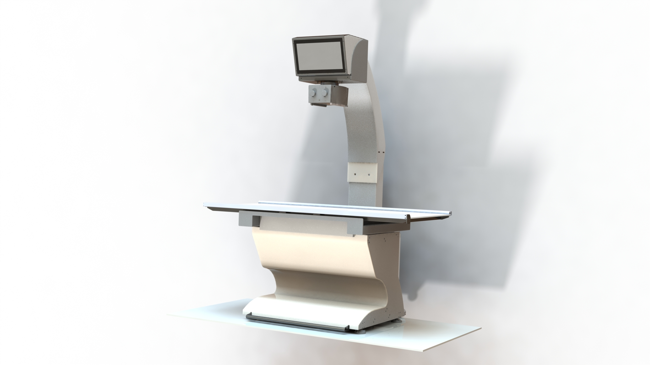
SkanVet ALTA High Power X-rays table for companion animals
URANUS

Slide 10
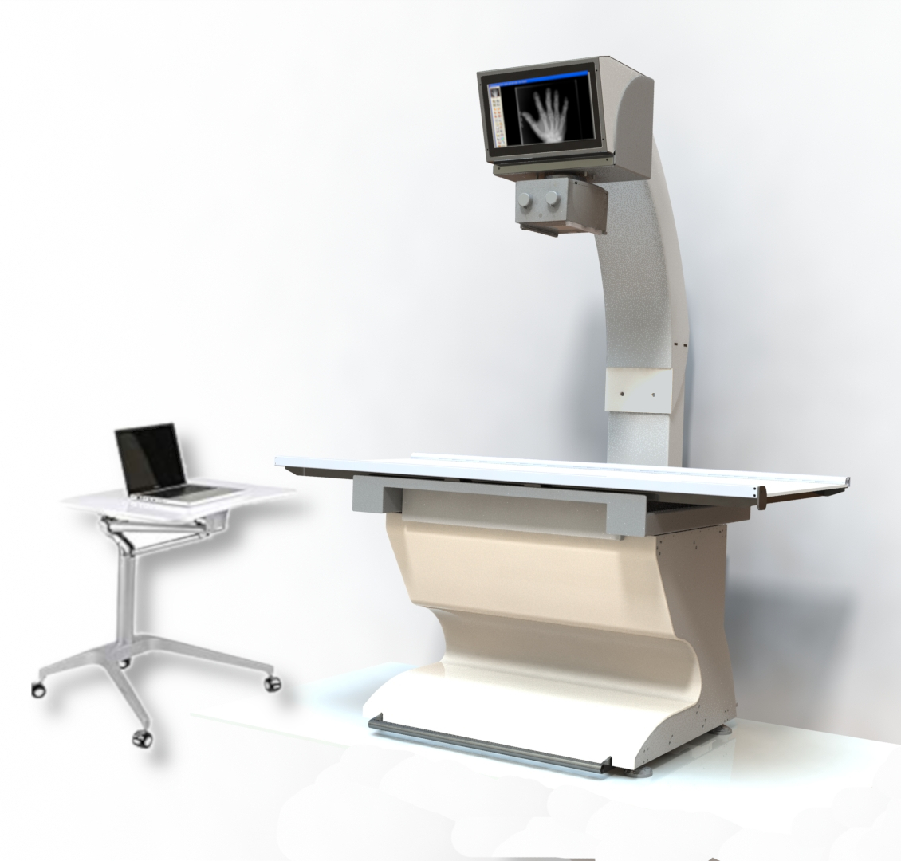
SkanVet ALTA High Power X-rays table for companion animals
JUPITER

